Slide 1

Lung Cancer Detection
Advance Topics in IC Design
Technische Universität München
Project Title: Lung Cancer Detection through Deep Learning
München, 28. January 2019
Ahmad Fahad, Ali Khan, Sarfaraz Habib, Zain Kabir
TEAM-8
Lung Cancer Detection | Group number 8 | Advance Topics in IC Design

Slide 2
Agenda
Introduction
Dataset
Model Architecture
Results
Model Reduction
Challenges Encountered
Conclusion
Lung Cancer Detection | Group number 8 | Advance Topics in IC Design

Slide 3
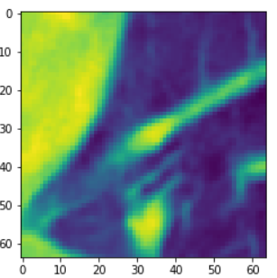
Introduction
Detection of Lung Cancer
CT scans images (Labeled Nodules from CT Scans)
Nodule specific Analysis
Classification using CNN
Categorization as
Malignant
Benign
Why Convolutional Neural Network?
Proven performance for image classification
Automatic Feature Extraction
Nodule region extracted from CT scan
Lung Cancer Detection | Group number 8 | Advance Topics in IC Design

Slide 4
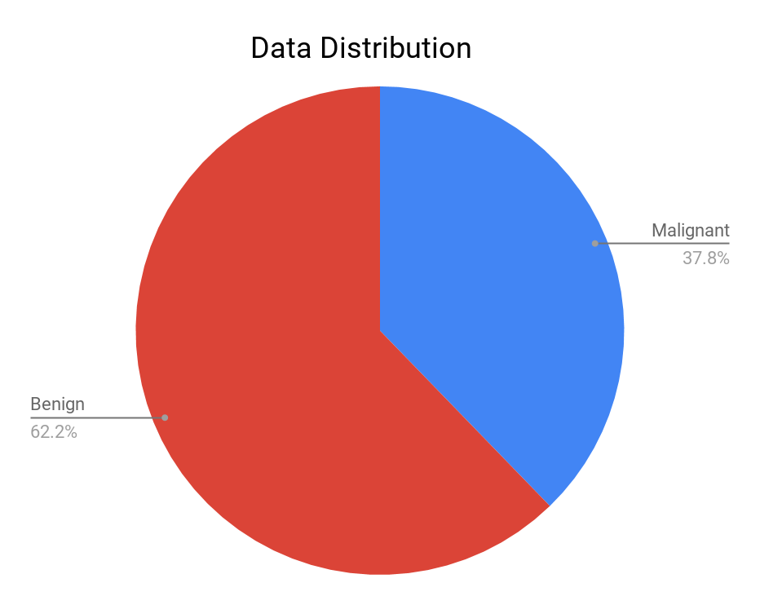
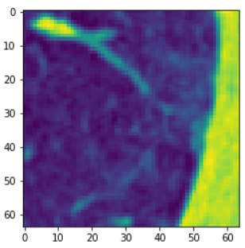
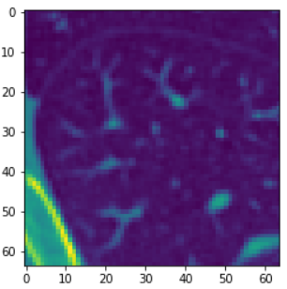
Data Set
Malignant
Benign
source: https://www.kaggle.com/kmader/lungnodemalignancy
Benign | Malignant | Total
4165 | 2526 | 6691

Slide 5
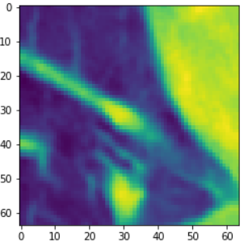
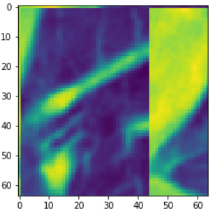
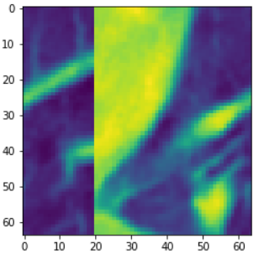
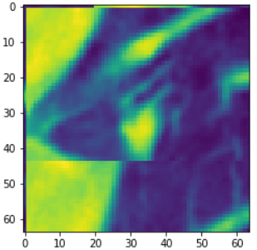
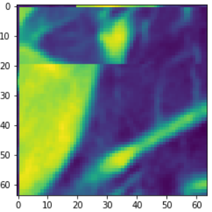
Data Augmentation
Original Image
Flipped Image
Left Translated
Right Translated
Up Translated
Down Translated
Lung Cancer Detection | Group number 8 | Advance Topics in IC Design

Slide 6
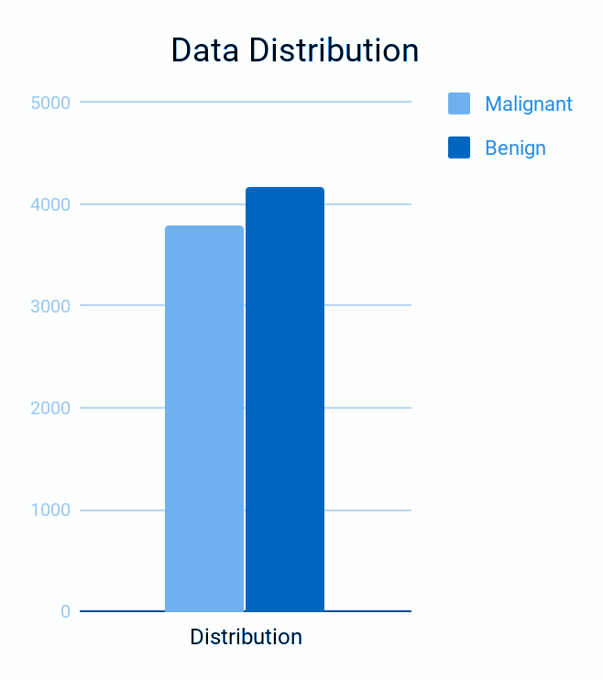
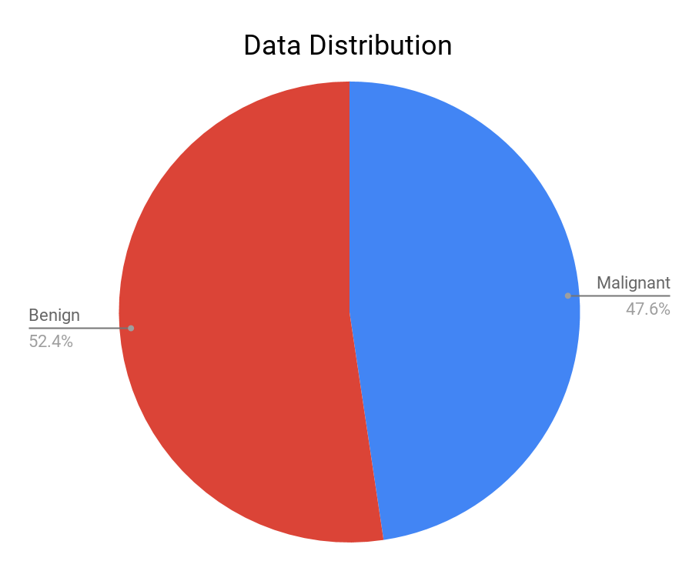
Data Augmentation Results
Benign | Malignant | Total
4165 | 3789 | 7954

Slide 7
Division of Data Set
Software\Libraries
Training data set | 6454 (80%)
Validation data set | 750 (10%)
Testing data set | 750 (10%)
Tools | Jupyter Notebook
Language | Python3
DL Framework | Keras (using TensorFlow backend)
Hardware | Raspberry Pi 3
Pruning | Keras-Surgeon

Slide 8
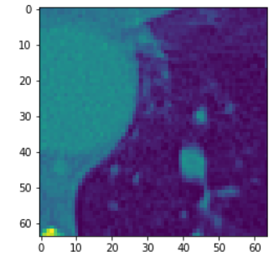
CNN Architecture
Malignant
or Benign
Input Image
Convolution Layer-1
Pooling
Convolution Layer-2
Pooling
Convolution Layer-3
Pooling
Fully Connected Layer
Input Dimensions | Convolution Layers | Pooling Layers | Fully Connected Layers | Outputs
64x64 | 3 | 3 | 2 | 2
Layer Information
Optimizer | Learning Rate | Exponential decay | Loss | Epochs | Batch size
Adam | 3e-4 | 1e-2 | Binary Cross Entropy | 30 | 32
Hyper-parameter & Optimizer

Slide 9
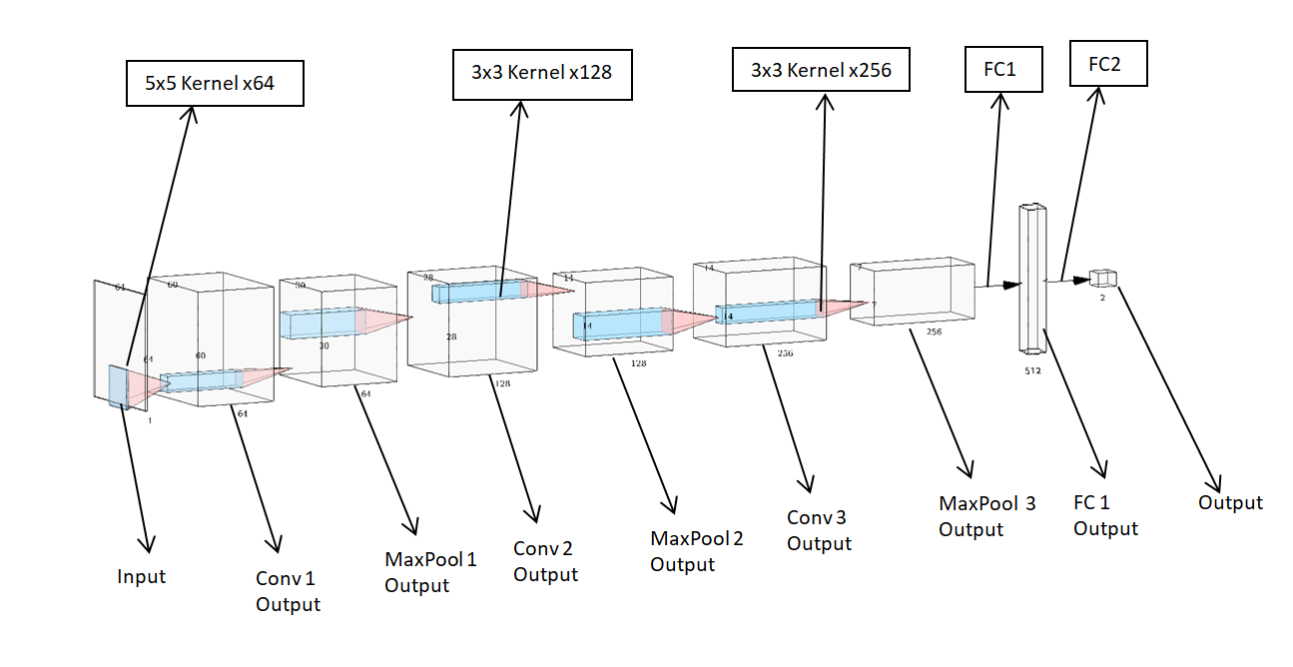
Model-1(Large Net) Results
Size | Number of Parameters | Test Accuracy | Loss | Fully Connected Layers
312 MB | 26,062,338 | 86.26 | 0.53 | 512-2

Slide 10
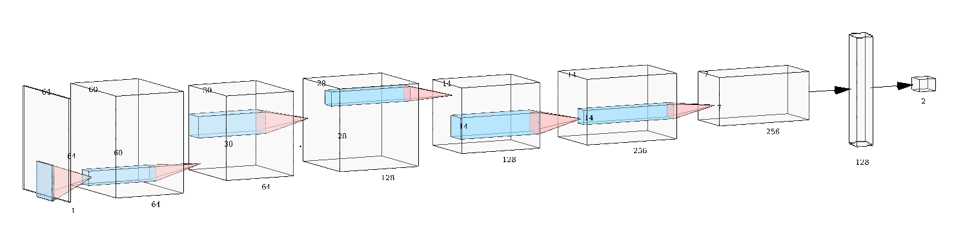
Final Model - Results
Size | Number of Parameters | Test Accuracy | Loss | Fully Connected Layers
24MB | 1,976,706 | 92.11 | 0.316 | 128-2

Slide 11
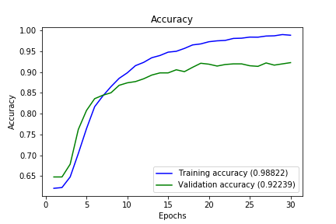
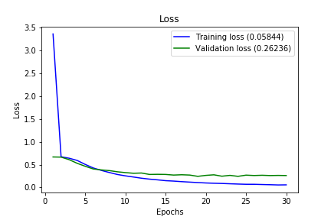
Final Model - Training Graphs
Size | Number of Parameters | Test Accuracy | Loss | Fully Connected Layers
24MB | 1,976,706 | 92.11 | 0.316 | 128-2

Slide 12
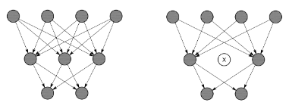
Model Reduction
Reduction performed in two following ways:
Network Reduction:
FC Connected layer reduced from 512 to 128 neurons
Network Compression of Final NW of 128 FC neurons
Approach used: Magnitude based Method:
Iterative Pruning + Retraining
Library used Keras-Surgeon
Identify neurons to prune using the method described in “Network Trimming: A Data-Driven Neuron Pruning Approach towards Efficient Deep Architectures (2016)”
Deletes neurons which have the highest Average Percentage of Zeros (APoZ)
Lung Cancer Detection | Group number 8 | Advance Topics in IC Design

Slide 13
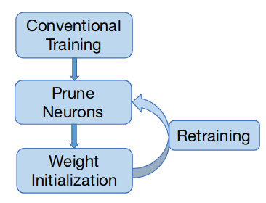
Pruning Algorithm
Network trimming method consists of following steps:
Network is trained under conventional process
Run the network on a large validation dataset to obtain the APoZ of each neuron.
APoZ: measure the percentage of zero activations of a neuron after the ReLU mapping.
Neurons with high APoZ are pruned according to certain criteria:
Takes APoZ of every neuron, plots standard deviation of their weights.
Drops neuron whose APOZ is higher than 0.99 or use Std deviation to identify neurons to be pruned
Initialize the network with prior weights
Retrain the network to enhance the performance of the trimmed network
Repeat from step 2 until performance is not degraded
Lung Cancer Detection | Group number 8 | Advance Topics in IC Design

Slide 14
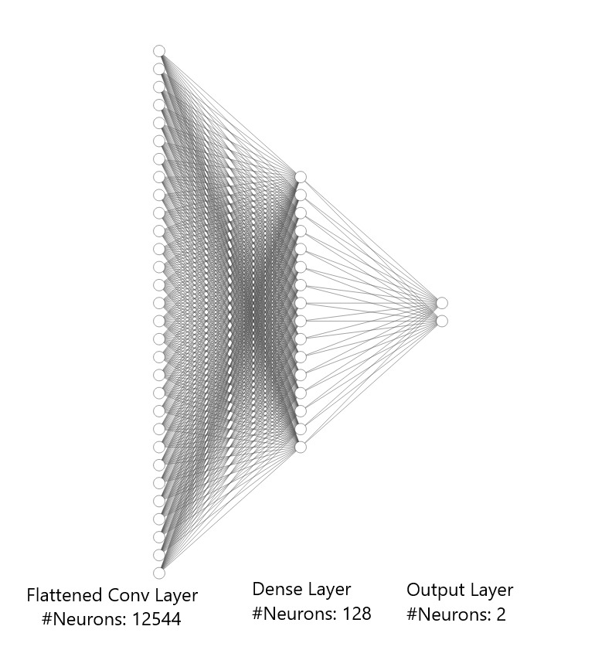
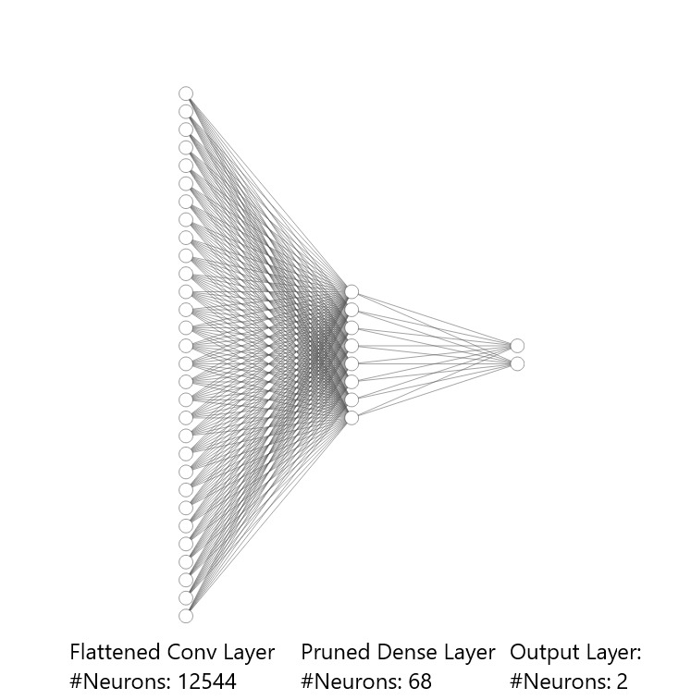
Pruning
Unpruned
Pruned

Slide 15
Pruning Results (1)
Size | Number of Parameters | Test Accuracy % | Test Loss
23.8 MB | 1,976,706 | 92.63 | 0.316
Unpruned
Size | Number of Parameters | Test Accuracy % | Test Loss | # neurons reduced
20.4 MB | 1,725,766 | 91.01 | 0.317 | 20
18.2 MB | 1,512,467 | 90.49 | 0.305 | 17
16.5 MB | 1,374,450 | 90.94 | 0.29 | 11
15.3 MB | 1,274,074 | 91.01 | 0.311 | 8
14.7 MB | 1,223,886 | 91.46 | 0.305 | 4
Stage-1
Stage-2
Stage-3
Stage-4
Stage-5
Pruned
1.6x reduction
Lung Cancer Detection | Group number 8 | Advance Topics in IC Design

Slide 16
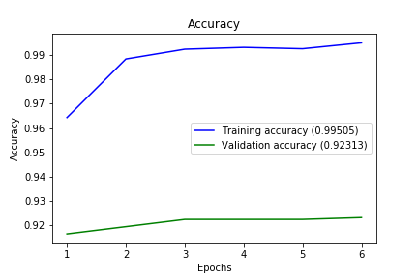
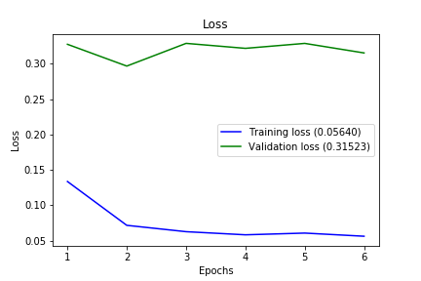
Pruning Results (2)
Training Accuracy
Training Loss

Slide 17
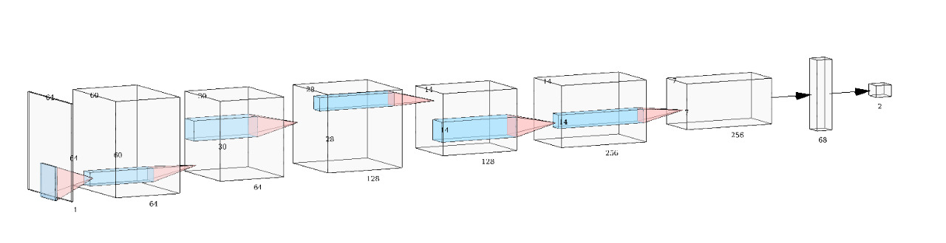
Architecture after 5th stage
Size | Number of Parameters | Test Accuracy | Loss | Fully Connected Layers
14.7 MB | 1,223,886 | 91.46 % | 0.305 | 68-2

Slide 18
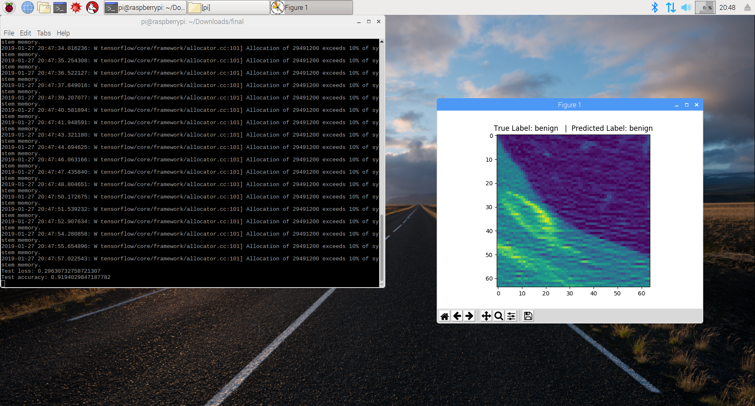
Demo
Successful implementation on Raspberry Pi.
Lung Cancer Detection | Group number 8 | Advance Topics in IC Design

Slide 19
Challenges
Challenges Faced | How we addressed
Finding right data set | initially started with X Rays (DICOM images) Nodule specific dataset accuracy improved
Tuning Hyper parameters | Finding correct learning rate and batch size
Model Reduction | Size reduction for embedded platform Implementation
Model Reduction vs Accuracy | Pruning stages vs accuracy
Lung Cancer Detection | Group number 8 | Advance Topics in IC Design

Slide 20
Conclusion
Successful inference of input images
Accuracy of 91.46% after pruning
Depreciation of only 1% in accuracy after 5 stages of pruning
Large model does not mean better performance
Lung Cancer Detection | Group number 8 | Advance Topics in IC Design

Slide 21
Questions?
Lung Cancer Detection | Group number 8 | Advance Topics in IC Design

